Slide 1



Minimizing AWS S3 attack vectors at scale
Notes:
Introduction – introduce yourself bio – say who you are.
Name – Damien Burks
I’m a Cloud Security Engineer at Citi bank currently, however, this presentation is this tool that I developed based on a noticeable gap within a particular AWS service for incident response purposes. So today, I’m going to talk about automated S3 blocking in AWS.
b

Slide 2



Who Am I?
Short Bio – (somewhat):
Currently a Cloud Security Engineer at Citi
Pursuing an M.S in Cybersecurity (one semester – w00t)
4x AWS Certified (and counting..): SAA, CDA, SCS, and CCP
Open-source contributor: DataCop, OPA (from time to time)
DevSecOps advocate and mentor
Father of 2 (kittens… that is)
Hobbies:
Videogames, Anime, and Cars

Slide 3

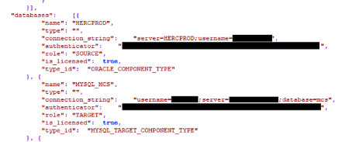
S3 Attack Vectors Explained
Buckets have been exposed quite frequently within the past couple of years.
Common Attack Vectors:
Data Exfiltration
Ransomware & Malware
Data Exfiltration
Personally Identifiable Information (PII)
Credentials & Tokens
Ransomware & Malware***
Depending on the intent of the malicious app, the impact could vary.
How does it happen?
Lack of access control
Lack of monitoring
Misconfiguration

Slide 4
Scenario: Genericx
An example organization, Genericx, is a mid-size mobile gaming company that caches server and user data within several S3 buckets and on-premise. This company operates out of a single account, utilizing several AWS services such as EC2, Lambda, and CodeCommit/CodeBuild. Within the past year, this organization has sold over 1000+ copies of their hit mobile game – AngryDolphins.
Shortly after the debut of their hit mobile game, the organization was hacked! The hackers gained access to their EC2 instance that was storing and retrieving PII and PCI data from a single S3 bucket (public).
Based on a recent report from CloudOne, the S3 bucket contained a malicious excel workbook loaded on the web server, creating a backdoor for hackers to SSH into the instance.
Notes:
Set this up ☺

Slide 5
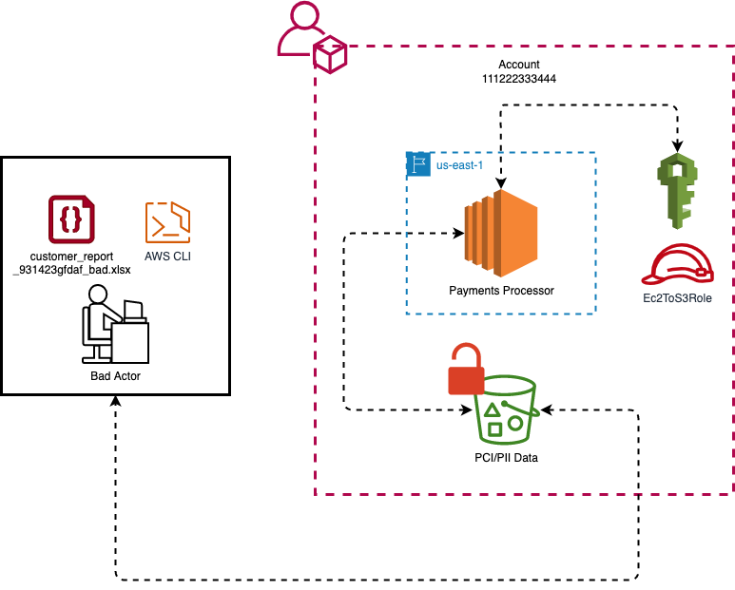
Genericx Architecture
Notes:
Add a toxic symbol to the PCI/PII data S3 bucket ☺

Slide 6





AWS Macie: Monitor/Scan S3 Buckets
Data security/privacy service that leverages machine learning and pattern matching to discover sensitive data in AWS, specifically AWS S3.
Automatically provides an inventory list of S3 buckets and classifies them.
Helps organizations meet data compliance regulations such as GDPR and HIPPA.
Notes:
Read the text book definition for Macie – and this is the symbol/logo

Slide 7
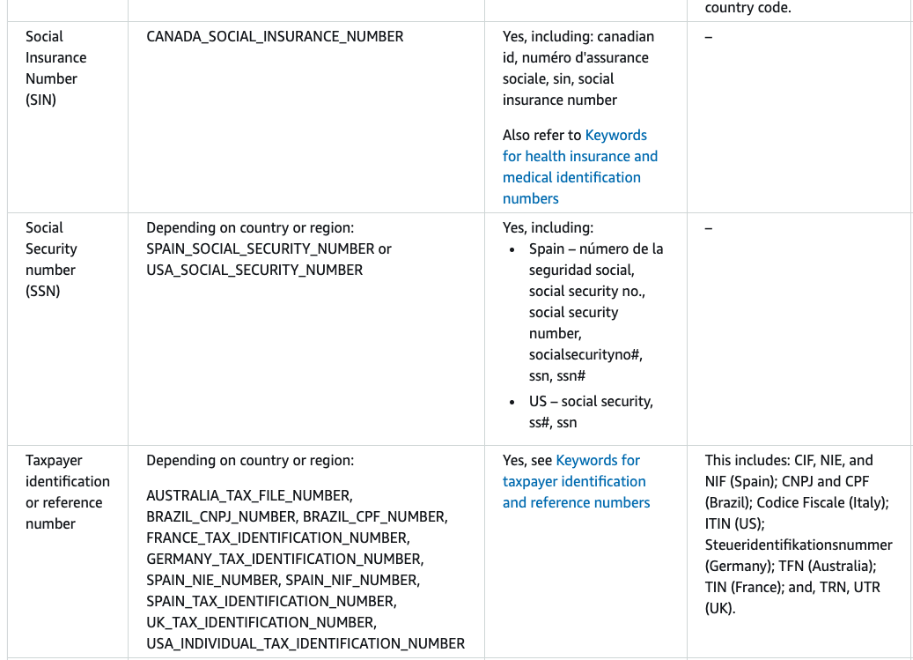
Macie: Pros & Cons
Pros
Fully-managed sensitive data types
Seamless integration with several other services such as AWS EventBridge, CloudWatch, and Step Functions.
Customizable data types and fields for data/risk classification
Can create automated sensitive data discovery jobs that run on a specific basis.
Cons
$$$ - Expensive
Returns a bloated JSON file
No feature available for auto-remediation of buckets. ☹
Macie’s Managed Data Types
Notes:
Pros:
Bullet 1: Fully-managed sensitive data types -> refer to the image on the left-hand side. AWS has data types and configurations for you to scan your files. SSNs, SINs, etc etc. It’s not just limited to a specific country – spans internationally
Bullet 2: Integration with other services – very important for the open source tool that I’ll discuss
Bullet 3: Customizable data types and fields for data classification: you can create your own data types and classifications for Macie
Cons:
Note that it is an expensive service due to the machine learning and pattern matching capability for each file within an S3 bucket.
No feature available for auto-rem of buckets ☹: it just tells you that this bucket is a risk (high, medium, low) and doesn’t tell you anything.

Slide 8
Trend Micro CloudOne – File Storage Security
Cloud-native security solution for S3 buckets and file systems.
Provides anti-malware scanning on files in multiple cloud environments such as AWS, Azure, and GCP
Detects several types of malware:
Viruses
Trojans
Spyware
Scans several file types:
.BIN
.EXE
.PDF
.ZIP
Notes:
Set this up ☺

Slide 9
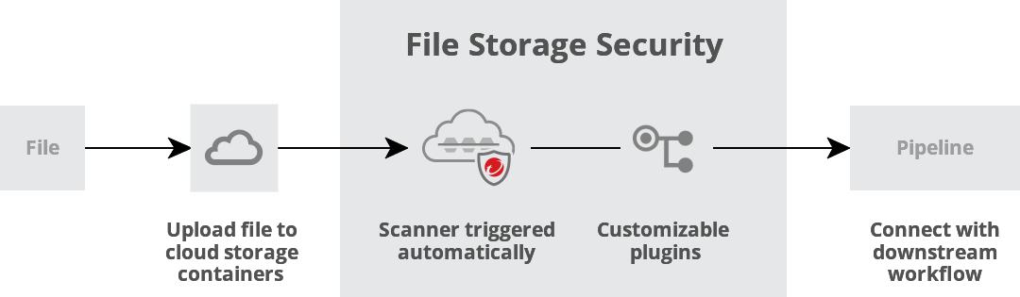
How does it work?

Slide 10
FSS: Pros & Con(s)
Pros
Supports scanning massive files (5GB or more)
Extremely fast scanning. Estimated between 3-25 secs.
Concurrent scanning (extremely scalable)
Easy deployment and extensibility.
Con(s)
It is not free ☺

Slide 11
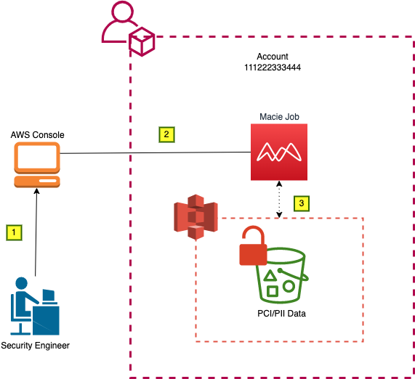
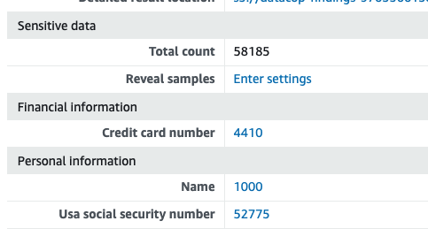
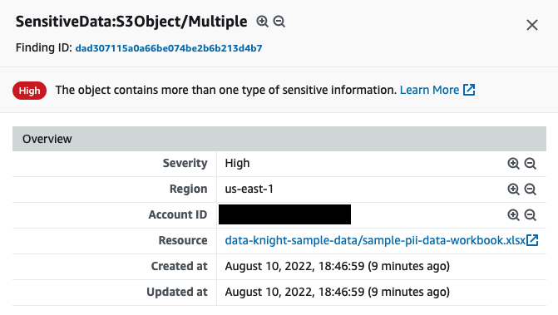
Scenario: Genericx w/ Macie
Notes:
Let’s say the architect,

Slide 12
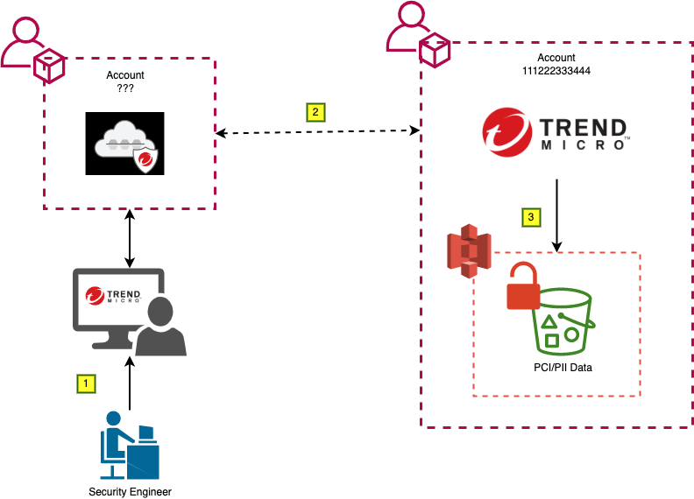
Scenario: Genericx & CloudOne FSS
Notes:
Per each S3 bucket, we have to iterate through this process:
Check the results from Macie in the S3 bucket
Parse through those results (which is a horribly long JSON file btw)
Check to see if this bucket is a high risk – and if it is, then we’re going to perform blocking actions
Done

Slide 13

Mitigation Strategy w/o Automation
Manual Mitigation FTW – NOT!
Action Steps (condensed):
Disable public access to S3 bucket
Attach a bucket policy that denies all access to resources/services
Inspect each object (file) and identify what the issue could be
If it has PII or PCI, move it to an on-prem server or file system
If not, figure out whether it is malicious or genuine.
If then if then…. How long will it take?

Slide 14
DataCop Overview
An open-source AWS framework that mitigates the potential of vulnerable S3 buckets.
Leverages Macie results to automatically block S3 buckets that contain PII or any classified information.
Features:
Automatically provisioned infrastructure to bridge the cap between Macie and S3 with AWS CDK and Python
Configurable settings for bucket blocking
Event-driven S3 bucket blocking
Easy to extend for other AWS security frameworks.
Notes:
AWS Cloud Development Kit (AWS CDK) is an open-source software development framework to define your cloud application resources using familiar programming languages.

Slide 15
“Considerations”
There are quite a few IAM permissions and policies that must be created in order for the following services to be utilized:
EventBridge
Lambda
CloudWatch
SNS
Step Function
S3
DataCop creates the needed roles and permissions for all the above services. However, it will not modify any SCPs that you have defined (intentional).
An S3 bucket for quarantining malicious files will be created.
Notes:
SNS – sending emails to end users
EventBridge – configured rules for detecting events to Macie’s result bucket
Lambda – used for performing blocking actions serverless
Step Function – visual workflow service that relies on the lambda to execute blocking actions in a specific order
IAM – Lots of permissions delegated to the role needed for the execution role.

Slide 16
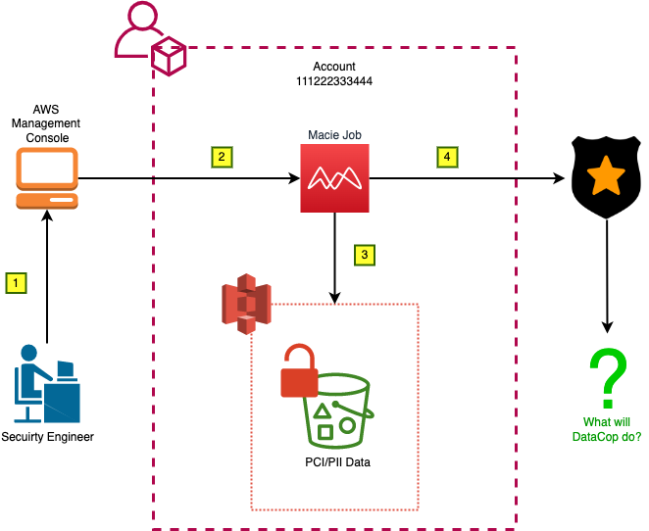
DataCop and Macie Architecture Preview
Notes:
Per each S3 bucket, we have to iterate through this process:
Check the results from Macie in the S3 bucket
Parse through those results (which is a horribly long JSON file btw)
Check to see if this bucket is a high risk – and if it is, then we’re going to perform blocking actions
Done

Slide 17
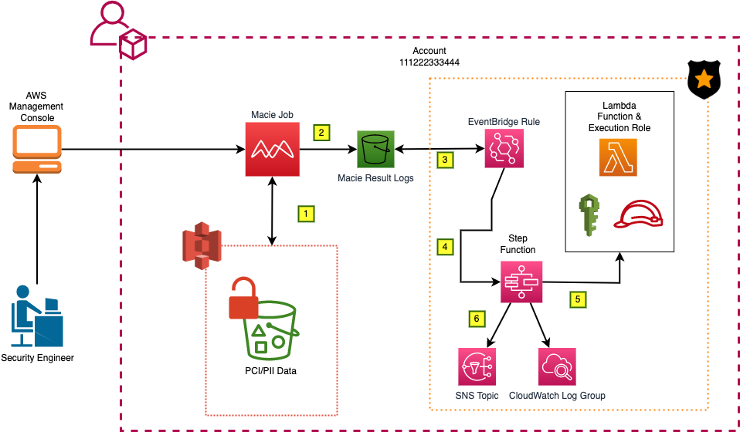
DataCop and Macie Architecture Walkthrough

Slide 18
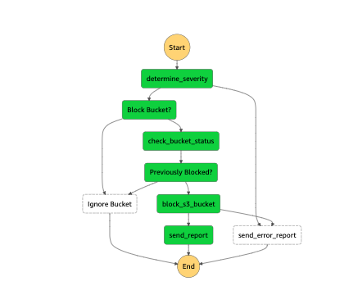
DC Macie State Machine
Total of seven states within a step function – or state machine.
Key states:
determine_severity
check_bucket_status
block_s3_bucket
send_error_report
send_report
Notes:
So about those states for the step function – what does it do?
States
determine_severity: Parses the Macie results file in S3 and grab the bucket
Check_bucket_status: Checks the bucket’s status to see if it has already been blocked
Block_s3_bucket_status: If not, then it’ll block the bucket by attaching two things (deny all policy) and revoking public access
Send_error_report: If anything happens at this state, or the determine_severity state, it’ll send an error report to the subscripted user-base
Send_report: Sends a report of the blocked bucket.

Slide 19
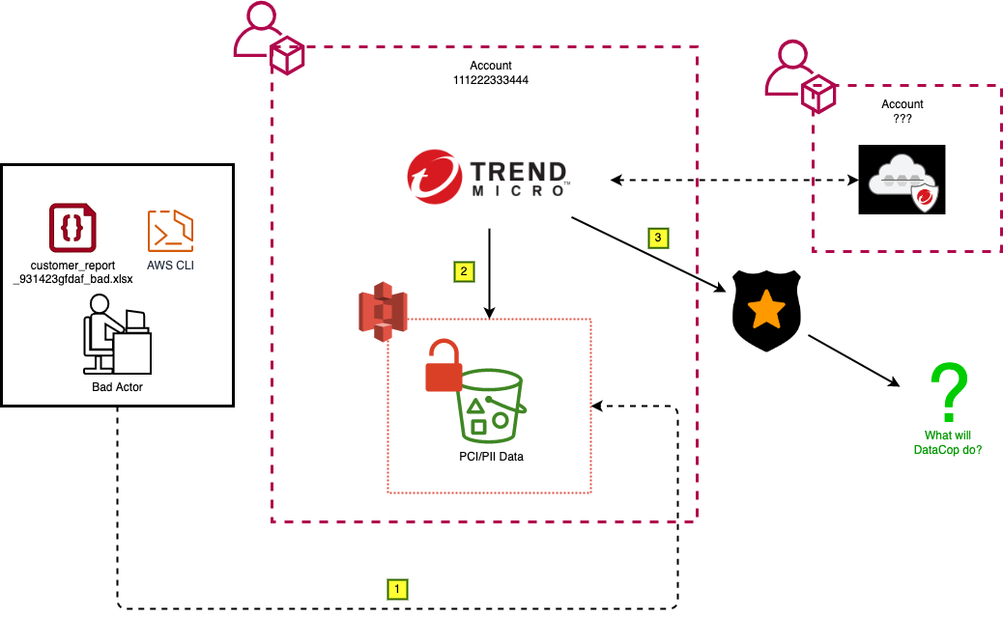
DataCop & FSS Architecture Preview
Notes:
Per each S3 bucket, we have to iterate through this process:
Check the results from Macie in the S3 bucket
Parse through those results (which is a horribly long JSON file btw)
Check to see if this bucket is a high risk – and if it is, then we’re going to perform blocking actions
Done

Slide 20
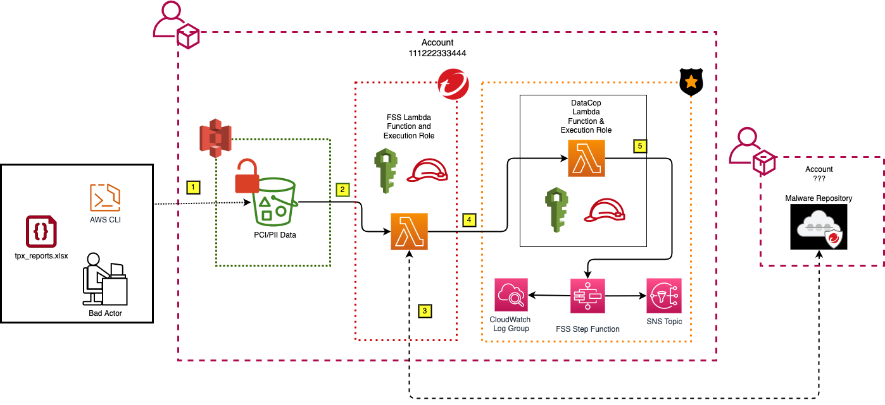
DataCop & FSS Architecture Walkthrough
Notes:
Per each S3 bucket, we have to iterate through this process:
Check the results from Macie in the S3 bucket
Parse through those results (which is a horribly long JSON file btw)
Check to see if this bucket is a high risk – and if it is, then we’re going to perform blocking actions
Done

Slide 21
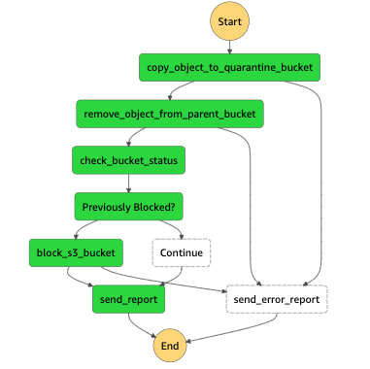
DC FSS State Machine
Total of eight states within a step function – or state machine.
Key states (only 5):
Copy_object_to_quarantine_bucket
Remove_object_from_parent_bucket
Block_s3_bucket
Send_report
Send_error_report
Notes:
So about those states for the step function – what does it do?
States
determine_severity: Parses the Macie results file in S3 and grab the bucket
Check_bucket_status: Checks the bucket’s status to see if it has already been blocked
Block_s3_bucket_status: If not, then it’ll block the bucket by attaching two things (deny all policy) and revoking public access
Send_error_report: If anything happens at this state, or the determine_severity state, it’ll send an error report to the subscripted user-base
Send_report: Sends a report of the blocked bucket.

Slide 22
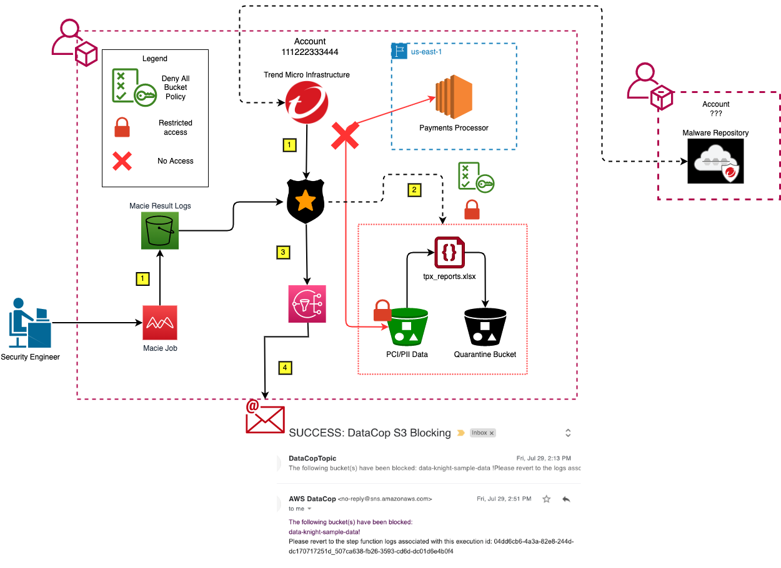
Fully Automated Solution
Notes:
So about those states for the step function – what does it do?
States
determine_severity: Parses the Macie results file in S3 and grab the bucket
Check_bucket_status: Checks the bucket’s status to see if it has already been blocked
Block_s3_bucket_status: If not, then it’ll block the bucket by attaching two things (deny all policy) and revoking public access
Send_error_report: If anything happens at this state, or the determine_severity state, it’ll send an error report to the subscripted user-base
Send_report: Sends a report of the blocked bucket.

Slide 23
Summary of what happened…
Minimized at least two attack vectors in AWS
Quick response time to any ‘malicious’ files
Completely scalable – can deploy into multiple accounts
Save a ton of hours on manual labor and analysis by eliminating the complexity of repetitive/mundane tasks for blocking S3 buckets.
Notes:
So about those states for the step function – what does it do?
States
determine_severity: Parses the Macie results file in S3 and grab the bucket
Check_bucket_status: Checks the bucket’s status to see if it has already been blocked
Block_s3_bucket_status: If not, then it’ll block the bucket by attaching two things (deny all policy) and revoking public access
Send_error_report: If anything happens at this state, or the determine_severity state, it’ll send an error report to the subscripted user-base
Send_report: Sends a report of the blocked bucket.

Slide 24


Thank you!

